Slide 1

ELECTION RESULT
2014 VS 2019
AKSHAY WAGHAVAKAR | DATA ANALYST
MUMBAI | 10 JUN 2024

Slide 2
Agenda
Problem Statement
Dataset overview
Reports
Insights

Slide 3
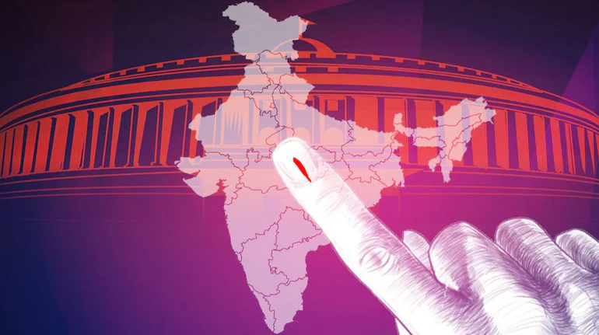
Problem Statement
AtliQ Media is a private media company and they wanted to telecast a show on Lok Sabha elections 2024 in India. Unlike other channels they do not want to have a debate on who is going to win this election, they rather wanted to present insights from 2014 and 2019 elections without any bias and discuss less explored themes like voter turnout percentage in India.

Slide 4
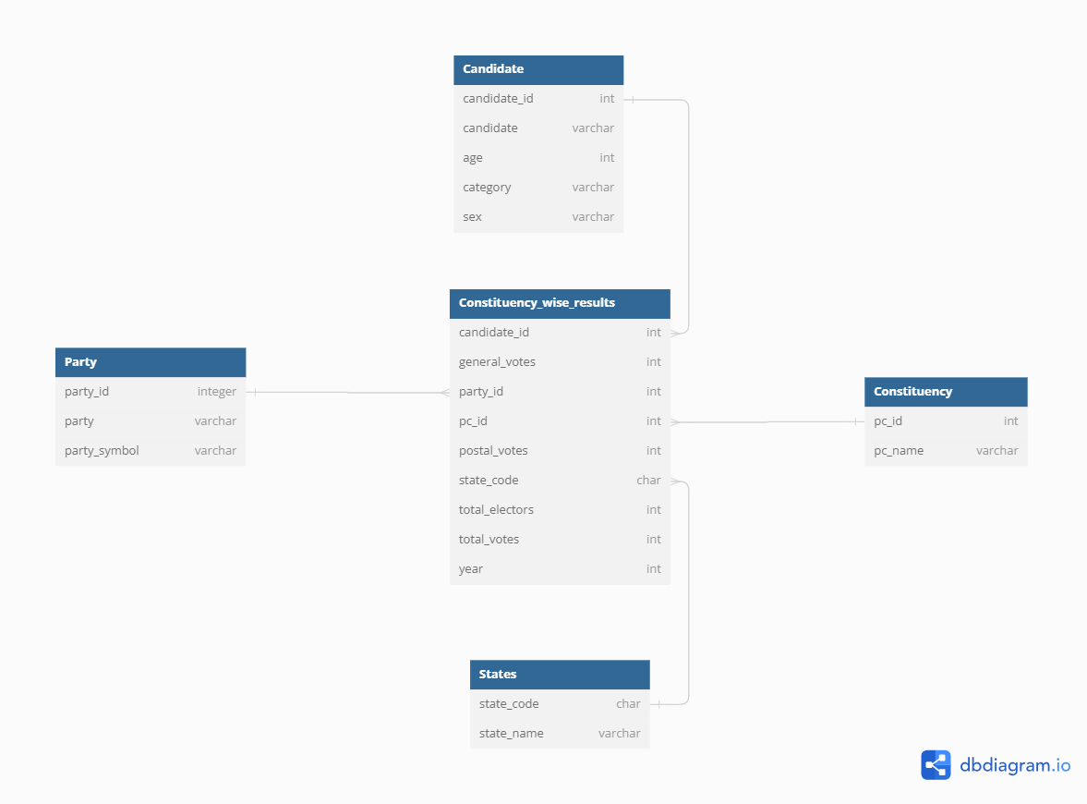
DATA SET OVERVIEW (Physical Data Model)

Slide 5
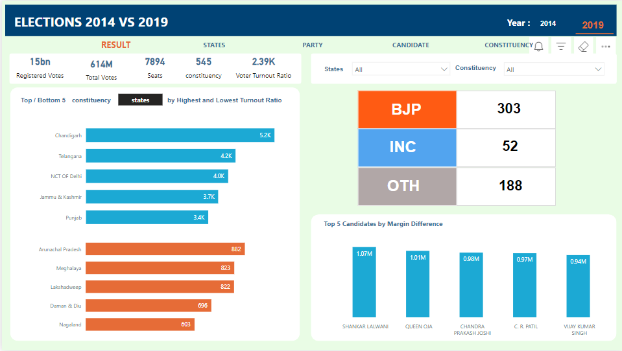

Slide 6
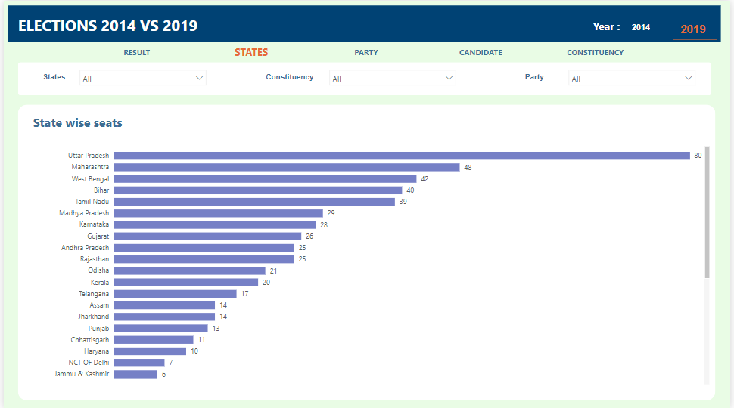

Slide 7
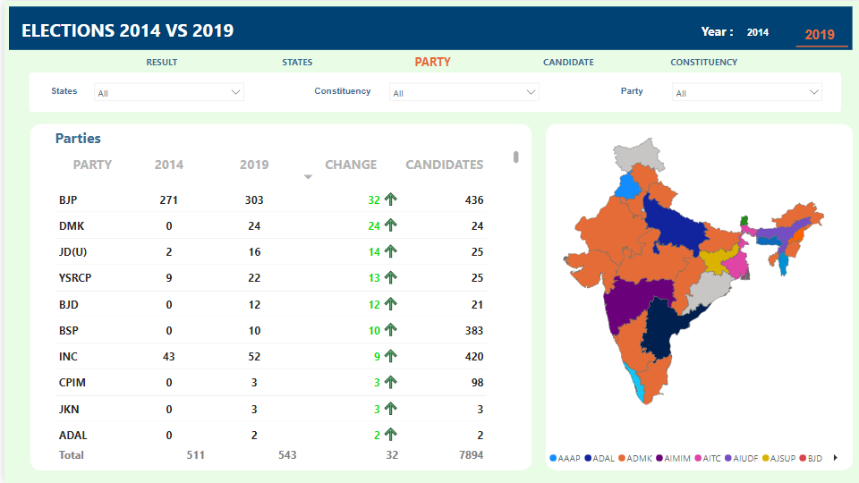

Slide 8
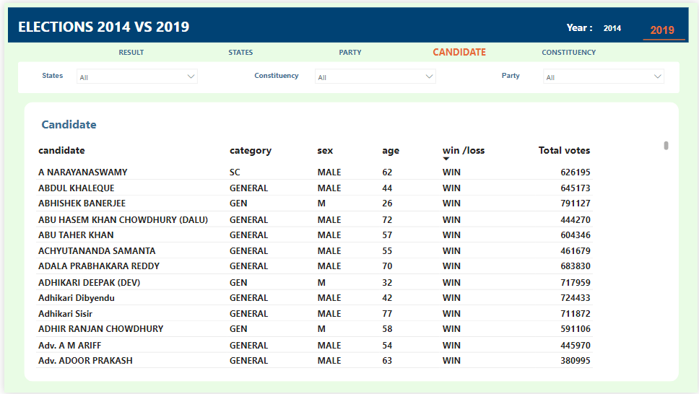

Slide 9
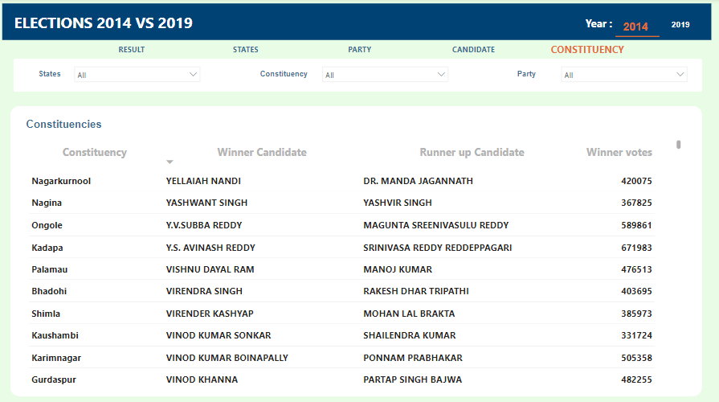

Slide 10
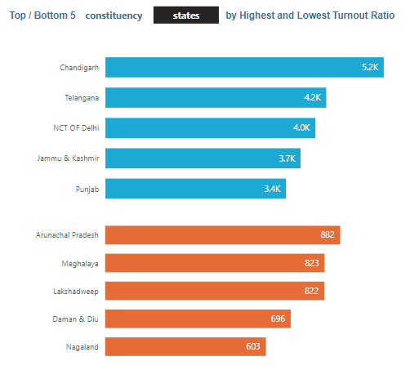
This bar chart shows the top / bottom 5 states and constituencies by highest and lowest turnout ratio.

Slide 11
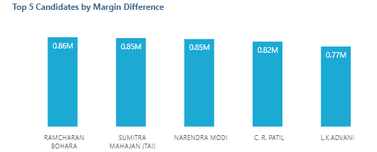
This column chart shows the top 5 candidates by margin difference with runner up candidates

Slide 12
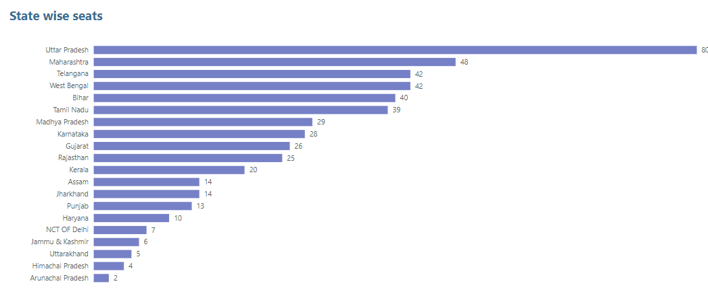
This shows the insights of state wise seats.
We can identify the top states by seats

Slide 13
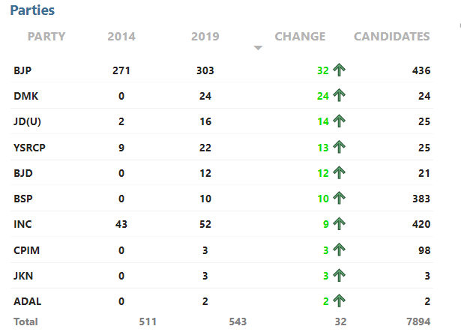
From this table chart we can see the winning seats of 2014 and 2029 Lok Sabha election and also with the change by parties.

Slide 14
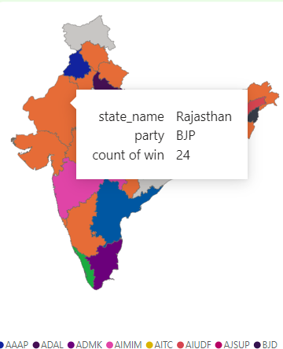
This map chart shows the winning seats of states by party

Slide 15
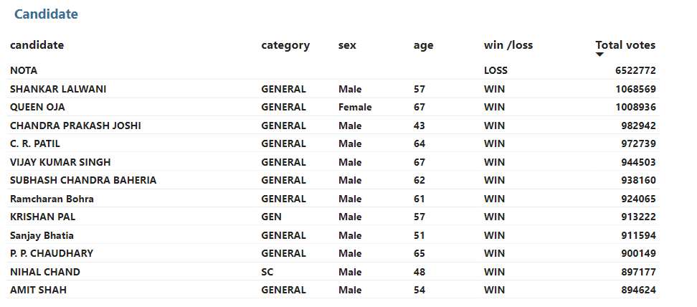
Thia table chart shows the information about candidates like category, sex, age, win or loss and the votes from the elections.

Slide 16
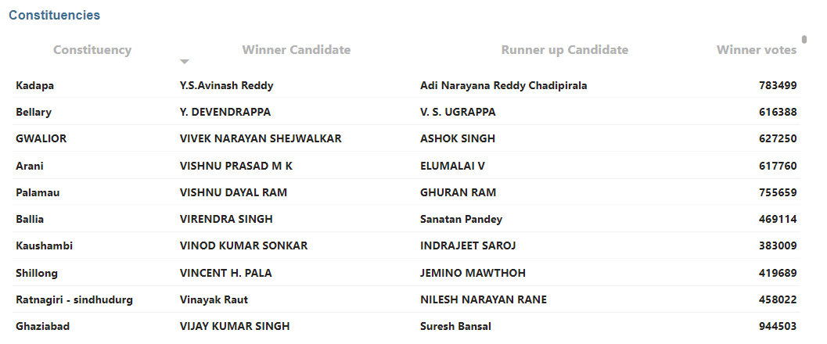
This chart shows the winner and runner up candidate by each constituency in details.

Slide 17

THANK YOU

